Slide 1
“Domain Fronting in 2025: A retro analysis”
DEFCON33 @ Malware Village (2025-08-08) ~ Presented by Tom Cope
(warning: this presentation and content was entirely human generated)
Notes:
30 min talk

Slide 2




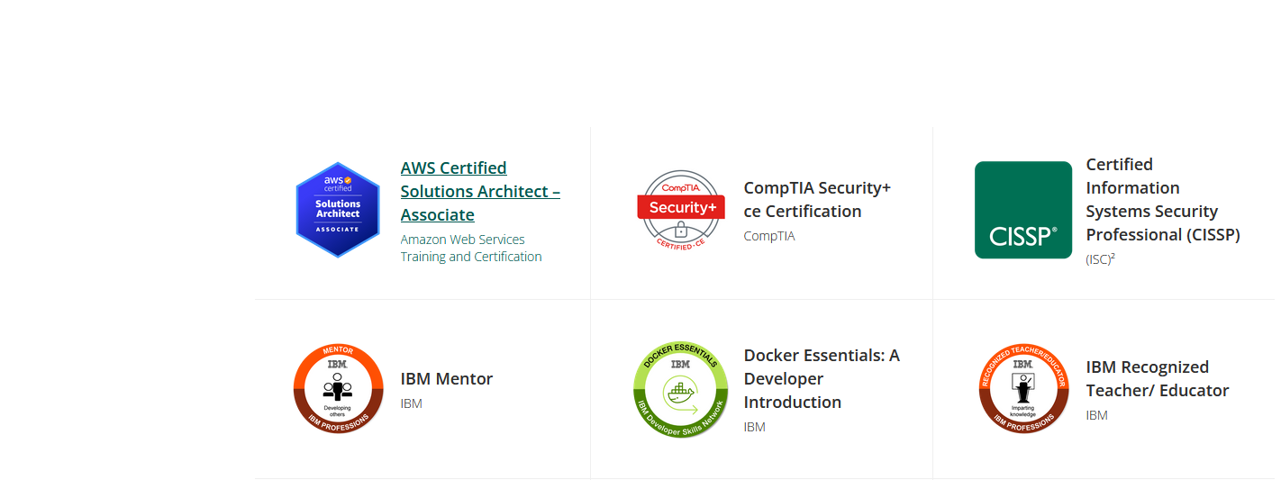
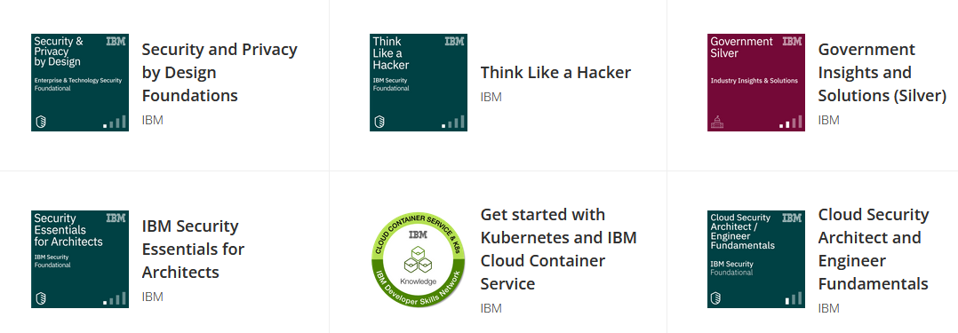
Hello World!
Tom Cope (https://tomcope.com)
Principal Consultant at Control Plane
Ex-CSO of Ava Security (now part of Motorola)
Security Engineer / SOC Analysis for UK leading asset manager
IAM SME at IBM
Working in Cyber Security ~12 years
Part time Security Researcher (CVE-2020-5014 + CVE-2021-29707)
CodeGate AI Write up coming soon!
Blue team by day, red team by night

Slide 3
Contents
Network Artifacts produced when hiding a C2
Define “Domain Fronting”
Recap “Traditional Domain Fronting”
Review other Domain Fronting Methods
Handy matrix included!
State of CDNs “Cooperation” in 2023
Research methodology
Retrospective: State of CDNs “Cooperation” in 2025
Notes:
There is a lot to cover in these slides, they will be available at the end, we can get through it together you can wlays go back through the slides

Slide 4
The Problem
Notes:
In practicality this was harder to get a definition of than I ralised

Slide 5
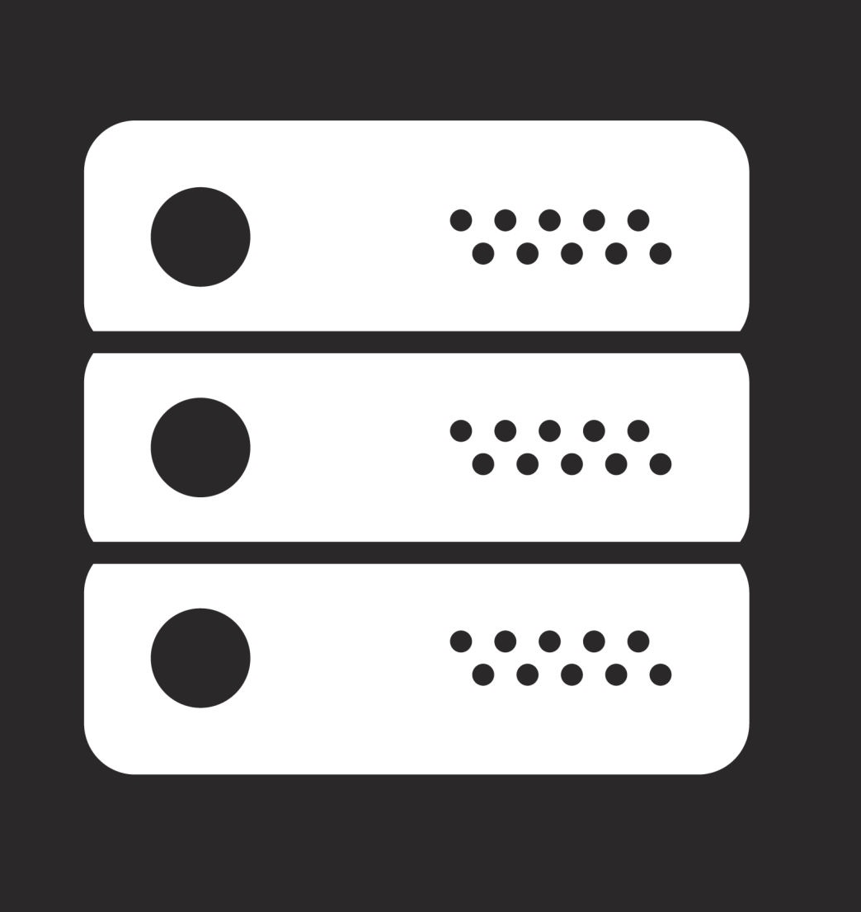

The Problem: Network Artifacts
IP Address - Leaks “evil” host
DNS Query (Plain Text) - Leaks “evil” host
TLS SNI (Plain Text) - Leaks “evil” host
HTTP Host (Remains Encrypted)
Defenders can detect and block
Q: evil.com
A: 5.6.7.8
Allows States to block access to specific websites / services
TCP: 5.6.7.8
TLS SNI: evil.com
HTTP Host: evil.com
evil.com
😈
Team server, etc

Slide 6
A popular solution:
Domain Fronting
Notes:
In practicality this was harder to get a definition of than I ralised

Slide 7
What is “Domain Fronting”
Notes:
In practicality this was harder to get a definition of than I ralised

Slide 8
Domain Fronting
“Domain fronting is a technique used to conceal the true destination of network traffic by disguising it as traffic to a different domain, by abusing both hosts being hosted behind the same CDN (Content Delivery Network) Service.”
Legitimate Use Cases:
Censorship bypass
(Telegram / Signal / Tor Bridge)
Malicious Use Cases:
Hiding C2 Traffic
Notes:
If you are in a hostile network environment then you can connect to these service and access stuff like signal

Slide 9




CDN (Content Delivery Network)
“A Content Delivery Network (CDN) is a collection of globally distributed servers that speed up web content delivery by serving it from locations closer to users, thereby reducing load times and enhancing reliability”
“Host your website behind us and we’ll make it faster and more secure”
Popular vendors: Cloudflare, Fastly, Bunny.net
112ms
12ms
fox.jpg
fox.jpg
Notes:
If you are in a hostile network environment then you can connect to these service and access stuff like signal

Slide 10
Classical “Domain Fronting”
Notes:
In practicality this was harder to get a definition of than I ralised

Slide 11
The Classic: TLS SNI and Host Mismatch
good.com
😊
TLS SNI: good.com
!=
HTTP Host: evil.com
Q: good.com
A: 1.2.3.4
TCP: 1.2.3.4
TLS SNI: good.com
HTTP Host: evil.com
evil.com
😈
David Fifield, Chang Lan, Rod Hynes, Percy Wegmann, and Vern Paxson. 2015.
Blocking-resistant communication through domain fronting. Proc. Priv. Enhancing
Technol. 2015, 2 (2015), 46–64.
CDN - Performs TLS termination
TLS SNI - good.com -> I host that
HTTP Host - evil.com -> Forwarding traffic
Team server, etc
Notes:
Mention the ref + What TLS SNI is

Slide 12
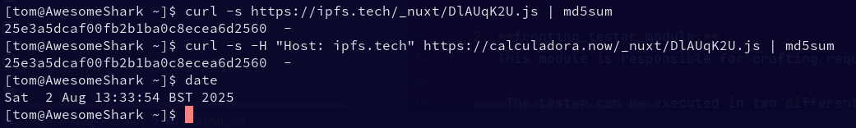
Curl Example
Desired Backend
Same Resource Served
Fronting domain

Slide 13
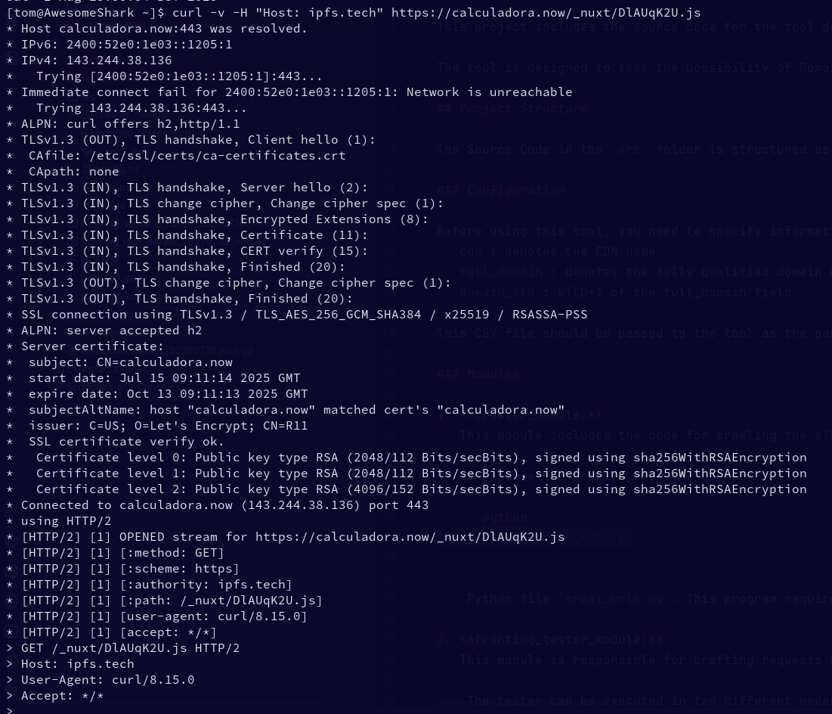

Connected to fronted domain
Encrypted
Plain text
Traffic routed to desired domain

Slide 14
The Classic: Network Artifacts
good.com
😊
DNS Query (Plain Text) - Leaks “good” host
TLS SNI (Plain Text) - Leaks “good” host
HTTP Host (Remains Encrypted)
Q: good.com
A: 1.2.3.4
TCP: 1.2.3.4
TLS SNI: good.com
HTTP Host: evil.com
evil.com
😈
From a passive network observer Beacon can talk to our team server while looking like it's talking to a legitimate website!
CDN - Performs TLS termination
TLS SNI good.com - I host that
HTTP Host - evil.com Forwarding traffic
Team server, etc

Slide 15
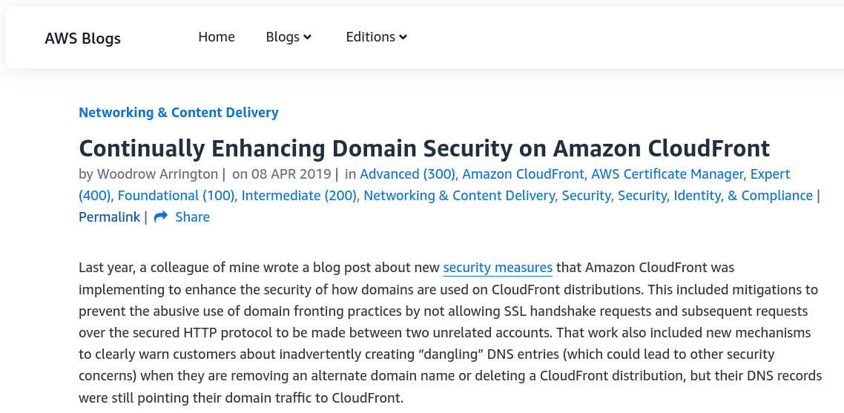
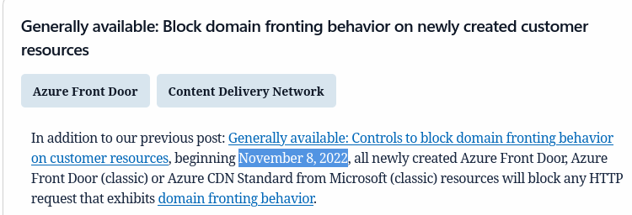
Changing Times - CDNs Cracking down on Domain Fronting
08 APR 2019 - AWS
November 8, 2022 - Azure
September 2015 - Cloudflare Changes
April 2018 - Google Cloud Changes

Slide 16


The Classic: CDN Blocking
good.com
😊
TLS SNI: good.com
!=
HTTP Host: evil.com
Q: good.com
😡
A: 1.2.3.4
TCP: 1.2.3.4
TLS SNI: good.com
HTTP Host: evil.com
evil.com
😈
CDN - Performs TLS termination
TLS SNI good.com - I host that
HTTP Host - evil.com Forwarding traffic
Team server, etc
https://signal.org/blog/looking-back-on-the-front/
Notes:
Notification of potential account suspension regarding AWS Service Terms

Slide 17
Alternatives? Yes! Many!
Notes:
In practicality this was harder to get a definition of than I ralised

Slide 18
Alternative: Fully Encrypted
Encrypted DNS Query (DoT / DoH)
TLS 1.3 ESNI (Encrypted Server Name ID)
HTTP Host (Remains Encrypted)
No Clear text network artifacts
IP Address of Evil server on the wire
Encrypted DNS (DoT / DoH)
Q: evil.com
A: 5.6.7.8
evil.com
TCP: 5.6.7.8
TLS ENCRYPTED SNI: evil.com
HTTP Host: evil.com
😈
Team server, etc

Slide 19
Alternative: CDN Masking (Posh C2)
good.com
😊
DNS Lookup “good” gets you a CDN entrypoint
Use the randomly generated CDN address to hide
CDN Proxy rules to switch origin based on User agent
CDNs allow you to specify any backend
TLS SNI Leaked
Q: good.com
A: 1.2.3.4
?
TCP: 1.2.3.4
TLS SNI: efgh.cdn.com
HTTP Host: efgh.cdn.com
?
evil.com
😈
https://github.com/nettitude/PoshC2
N.B - This technique is also sometimes referred to as “Domain Fronting”, the difference being that here that only the IP is masked by connecting to a CDN. No attempt is made to mask the TLS SNI like in classical domain fronting
CDN
abcd.cdn.com = good.com
efgh.cdn.com = evil.com
Team server, etc
Notes:
Mention cloudfront random domains and CDN subdomains, difficult for defenders to work out

Slide 20
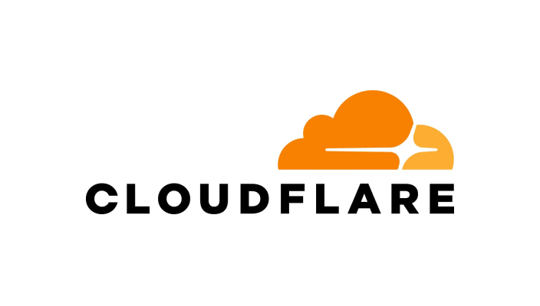
Alternative: Domain Hiding
Encrypted DNS Query for domain (required for ESNI public key)
TLS 1.3 ESNI (Encrypted Server Name ID)
HTTP Host (Remains Encrypted)
No Clear text network artifacts
IP Address of CDN Server
Added decoy SNI to trick defenders
Not Widely Supported
Blocked in Enterprises
Blocked in Some Countries
Q: evil.com
A: 5.6.7.8
😡
TCP: 5.6.7.8
TLS ENCRPTED SNI: evil.com
TLS SNI: good.com
HTTP Host: evil.com
evil.com
😈
Defcon 28
Erik Hunstad
“Domain Fronting is Dead, Long Live Domain Fronting Using TLS 1.3” (2020)
CDN
Hosting = evil.com
TLS SNI: good.com
!=
TLS Encrypted SNI: evil.com
Team server, etc

Slide 21

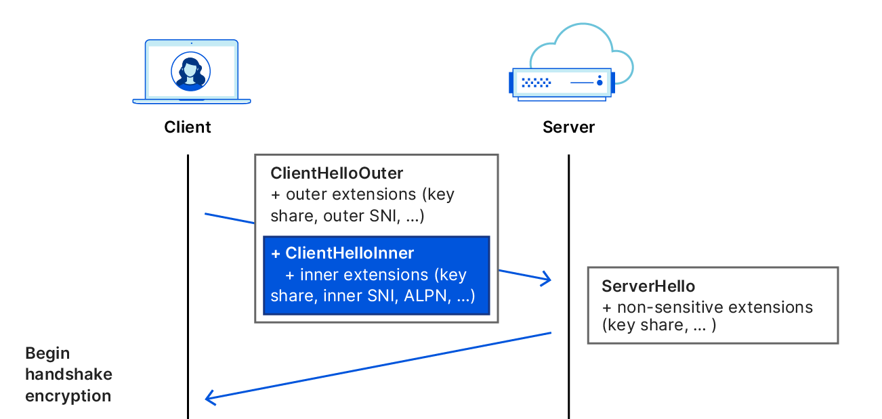
Domain Hiding - Back again?
😡
Decoy SNI provided with ESNI
“Good-bye ESNI, hello ECH!”
https://blog.cloudflare.com/encrypted-client-hello/
TLS 1.3 standard
“Outer SNI” could be the new Decoy SNI!
Possible research topic
Jose Plascencia has beaten me to it!
/\ - 15:00 (Red Team Village)

Slide 22
Alternative: Domain Shadowing
https://signal.org/blog/proxy-please/
Can be used with or without encrypted DNS & ESNI
CDN allows any backend origin (no ownership proof)
Register any new domain (or don’t!!!!!)
CDN77 accepts unregistered front
domains Into their network
Bypass by blocklist based protections
Good for bypassing censorship
Q: dogs.com
A: 7.8.9.0
TCP: 7.8.9.0
TLS ENCRPTED SNI: dogs.com
HTTP Host: dogs.com
evil.com
😈
“Domain Shadowing: Leveraging Content Delivery Networks for
Robust Blocking-Resistant Communications”
Mingkui Wei -
George Mason University - Presented at https://www.usenix.org/ (2021)
CDN
dogs.com
Team server, etc

Slide 23
Last one! Alternative: Domain Borrowing
Register any arbitrary frontend domain with a CDN
Not all CDNs
But some (👀CDN77👀)
Register your backend associated with “borrowed” frontend
Abuse CDN wildcard certificate handling for “borrowed” sub-domains already part of their network on a different account
Q: cats.cute.com
A: 1.1.2.9
TCP: 1.1.2.9
TLS SNI: cats.cute.com
HTTP Host: cats.cute.com
evil.com
😈
Domain Borrowing: Catch My C2 Traffic If You Can.
BlackHat 2021
Tianze Ding / Junyu Zhou
CDN
cats.cute.com - Registered by Attacker
cats.cute.com -> Forward to -> evil.com
cute.com - Registered by true owner
CDN “bug” causes wildcard certificate to be returned and traffic served
Team server, etc

Slide 24
Corporate Environment & Proxies

Slide 25
TLS Interception Proxies - Corporate
Technique | Passive Network Observation | HTTP “CONNECT” Proxy | Full TLS Interception | TLS 1.3 Required (ESNI / ECH) | Requires CDN “Cooperation” | Domain Ownership
TLS SNI & Host Missmatch | 🫣 | 🫣 | 👎 | ❌ | 🫤 | 🤷
Fully Encrypted | 👀 (ip) | 👀 (ip) | 👎 | ✅ | ❌ | 🙋‍♂️
CDN Masking | 💧 | 🫣 | 💧 | ❌ | ❌ | 😶‍🌫️
Domain Hiding | 🫣 | 🫣 | 👎 | ✅ | ❌ | 🙋‍♂️
Domain Shadowing | 💧 | 🫣 | 👎 | ❌ | ❔ | 😶‍🌫️
Domain Borrowing | 🫣 | 🫣 | 🫣 | ❌ | 🫤 | 🤷
Notes:
Talk about poshc2 causing us to run around circles because it was a connect proxy request for a domain owning to a finance company which was not fully incepted and then it was able to access the host./ You can use certificate pinning to detect changed in your C2

Slide 26
TLS Interception Proxies - Corporate
Technique | Passive Observation | TLS Interception | TLS 1.3 Required (ESNI / ECH)
TLS SNI & Host Missmatch
Fully Encrypted
CDN Masking
Domain Hiding
Domain Shadowing
Domain Borrowing
Domain default allow list
Eg: Palo Alto Networks Predefined Decryption Exclusions
Excluded for Legal Reasons = Health Care / Finance
→ Choose your domain carefully ←
If forced, TLS 1.3 Only with client downgrade protections
=
Bypasses some proxies,
Blocked by other

Slide 27
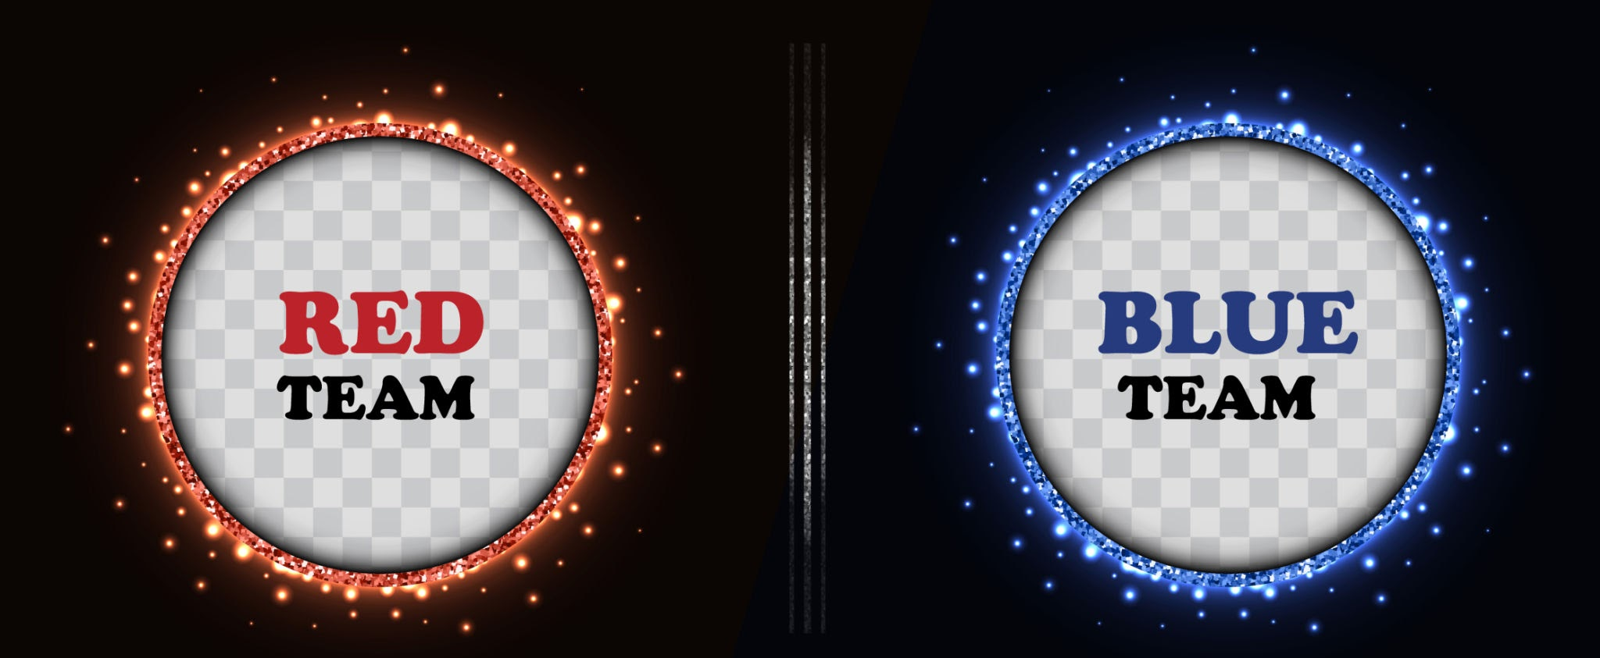
The Shenanigans are still alive…
These techniques are still out there and still valid, have a go at them!
I should look into domain fronting for my next engagement
I should look into my proxy config

Slide 28
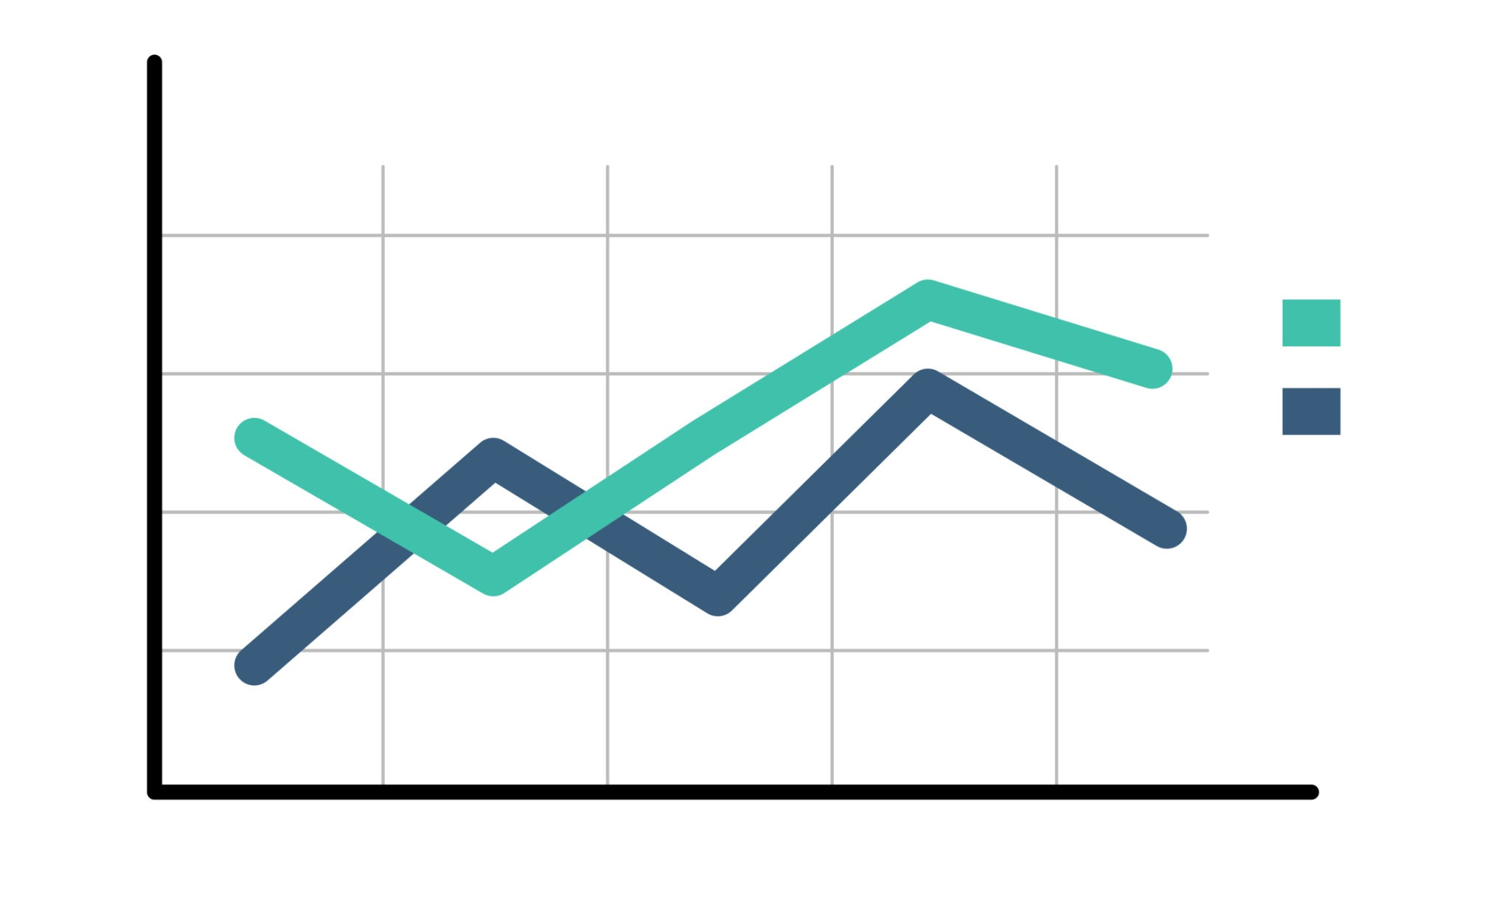
Motivation - CDN “Cooperation”
Traditional domain fronting
TLS SNI != HTTP Hosts
How many CDN’s have implemented mitigations?
How can we take a data driven approach?
Talk about optics, companies do not want to be seen supporting malware but also don't want to help support bypass censorship, allowed countries to control internet traffic

Slide 29
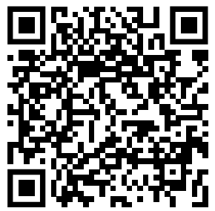
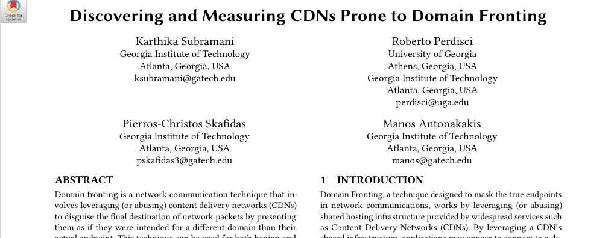
“Great Science is built on the Shoulders of Giants” - Sir Isaac Newton

Slide 30
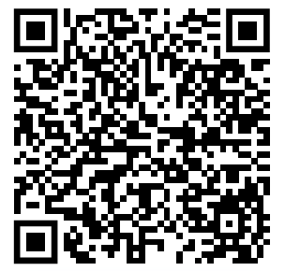
Methodology - 2023
https://github.com/karthikaS03/DomainFrontingDiscovery
Gather a list of CDNs and their subdomains (Manual process)
BunnyCDN = xyz.bunnycdn.com
Gather Passive DNS Dataset (March 20, 2023 -> March 30, 2023)
University networks
Tranco & Active DNS Project

Slide 31
Methodology - 2023
Match Domains visited with CDN subdomains via CNAME search
dogs.com -> dogs.bunnycdn.com -> Asset
Crawl websites with Puppeteer to find Static CDN served resources
“/” not reliable
Crawler_module - find static assets (*.css / *.js)

Slide 32
Methodology - 2023
Create cross domain test cases
dogs.com - BunnyCDN
cats.com - BunnyCDN
Test host running being the same CDN
Test Sites!
fronting_tester_module

Slide 33
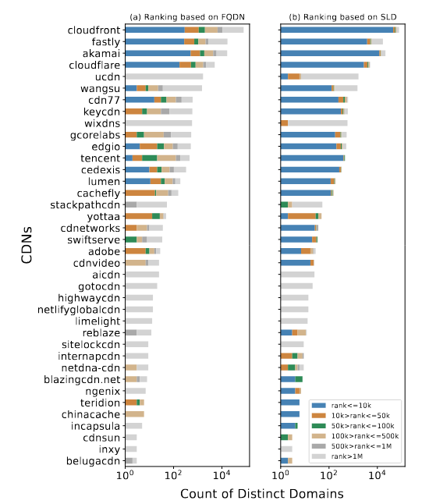
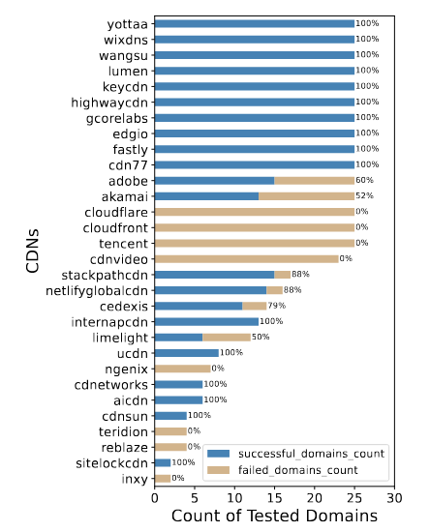
Classical domain fronting still possible
(2023)

Slide 34
Replicating the Research - 2025
https://github.com/copethomas/defcon-33-domain-fronting
https://github.com/copethomas/DomainFrontingDiscovery
Use ASN numbers instead of subdomains
www.lloydsbank.com -> s5933.cdn.lloydsbanking.com -> Akamai address without using the Akamai subdomain (akamaiedge.net)
Gather a list of CDNs and their ASN (Manual Process, bit of a pain)
BunnyCDN = AS200325
A lot can change in 2 years - CDN companies get bought and merged…

Slide 35
Replicating the Research - 2025
ASN to IP (https://iptoasn.com)
`go run cmd/cdn-asn-ip-map/main.go`
Gather Passive DNS Dataset
University networks ❌
Tranco & Active DNS Project 👻❌

Slide 36
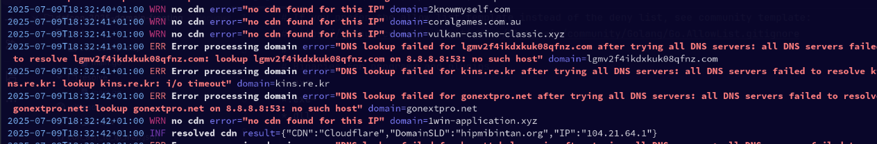
Replicating the Research - 2025
Gather a active DNS Dataset!
Use the https://tranco-list.eu/ - For the top 1 million domains
Resolve DNS using an array of global resolvers
Map the IP -> ASN Range -> CDN
`go run cmd/resolve/main.go`
Now I have a nice list of Website -> CDN

Slide 37
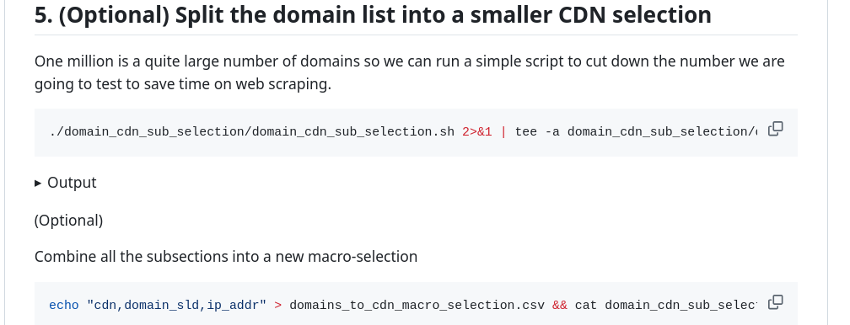
Replicating the Research - 2025
I’m not a web scraping expert
Web scraping is a pain
I would use https://commoncrawl.org/ next time
1M domains 😬 -> 100 per CDN 😅 41 different CDNs

Slide 38
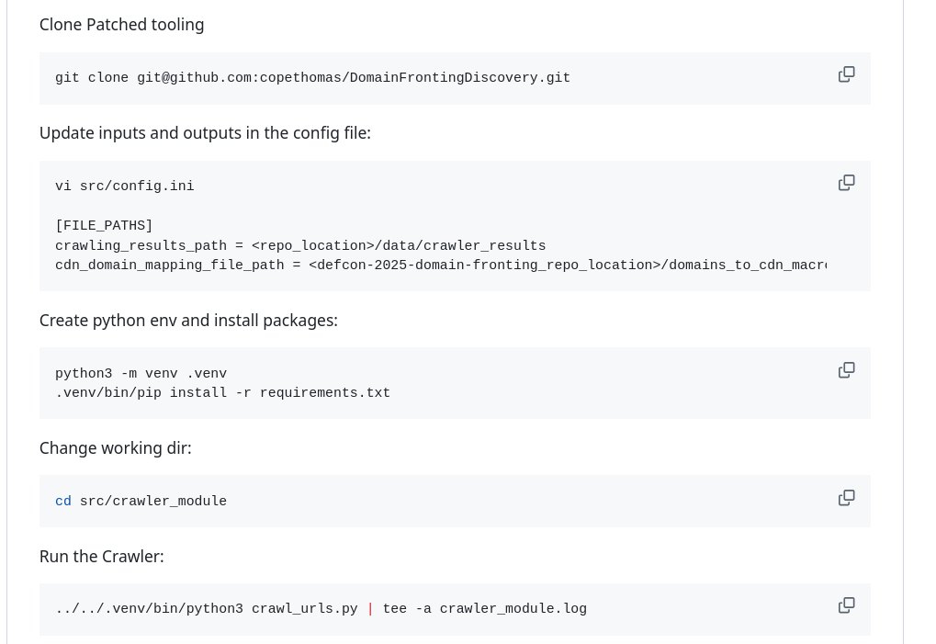
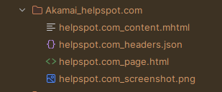
Replicating the Research - 2025
Web Scraping time: ~1 Day
41 CDNS x ~100 each

Slide 39
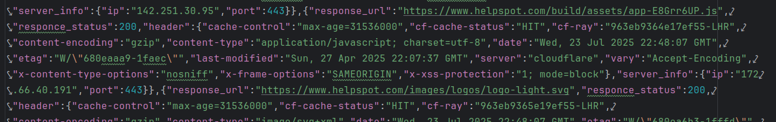
Replicating the Research - 2025
All assets loaded on the page (including ones via a CDN)

Slide 40
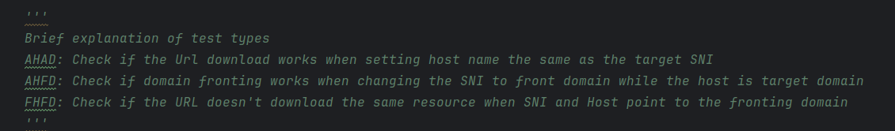
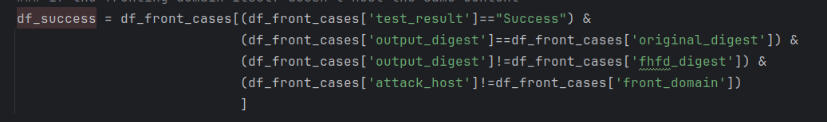
Replicating the Research - 2025
Filter URLs for only static resources
Create tests cases for domains hosted behind the same CDN
Perform tests to see if domain fronting is successful for each test case
`python FrontingTester.py batch`

Slide 41
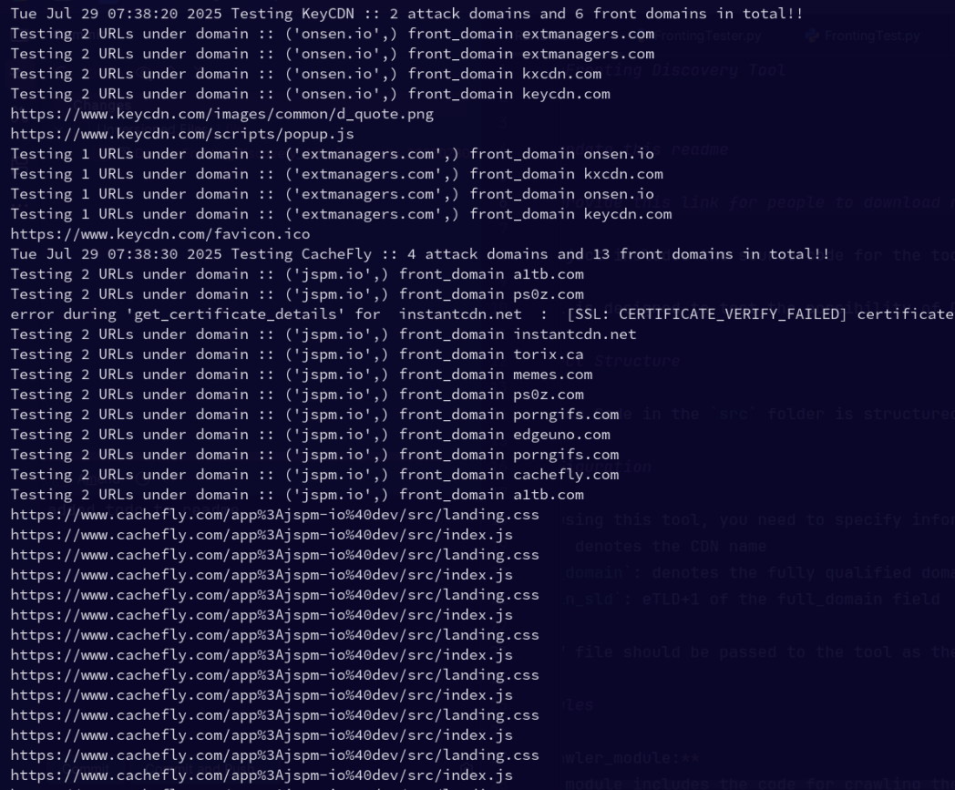
Replicating the Research - 2025
41 different CDNs
2371 Domains X 2+ test cases
Took about ~3 Days
Testing each Site & CDN for domain fronting support…
Full download 6GB test results available on Git Repo

Slide 42
The Results!

Slide 43
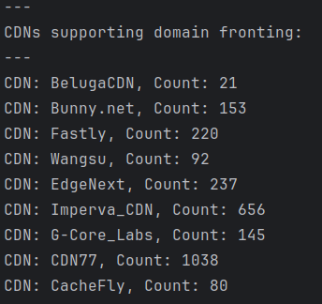
2025 Results!
9/41 CDNs tested support domain fronting = 21.9%
✅
Many CDNs tested in 2023 have not changed their support
✅
✅
✅
Domain Fronting is still very possible!

Slide 44
2023 vs 2025
Testing for domain fronting can be difficult
Testing methodology is not perfect
Does not take into account CDN ToS and “grandfather” accounts
Domain fronting is still possible across a selection of CDNs

Slide 45
Summary
“Classic Domain Fronting” still works!
There is more than 1 way to hide your traffic
Every CDN has their quirks!
CDNs are consolidating
Many from 2023 no longer exist or have merged with other CDNs
Good Luck, Have Fun!

Slide 46

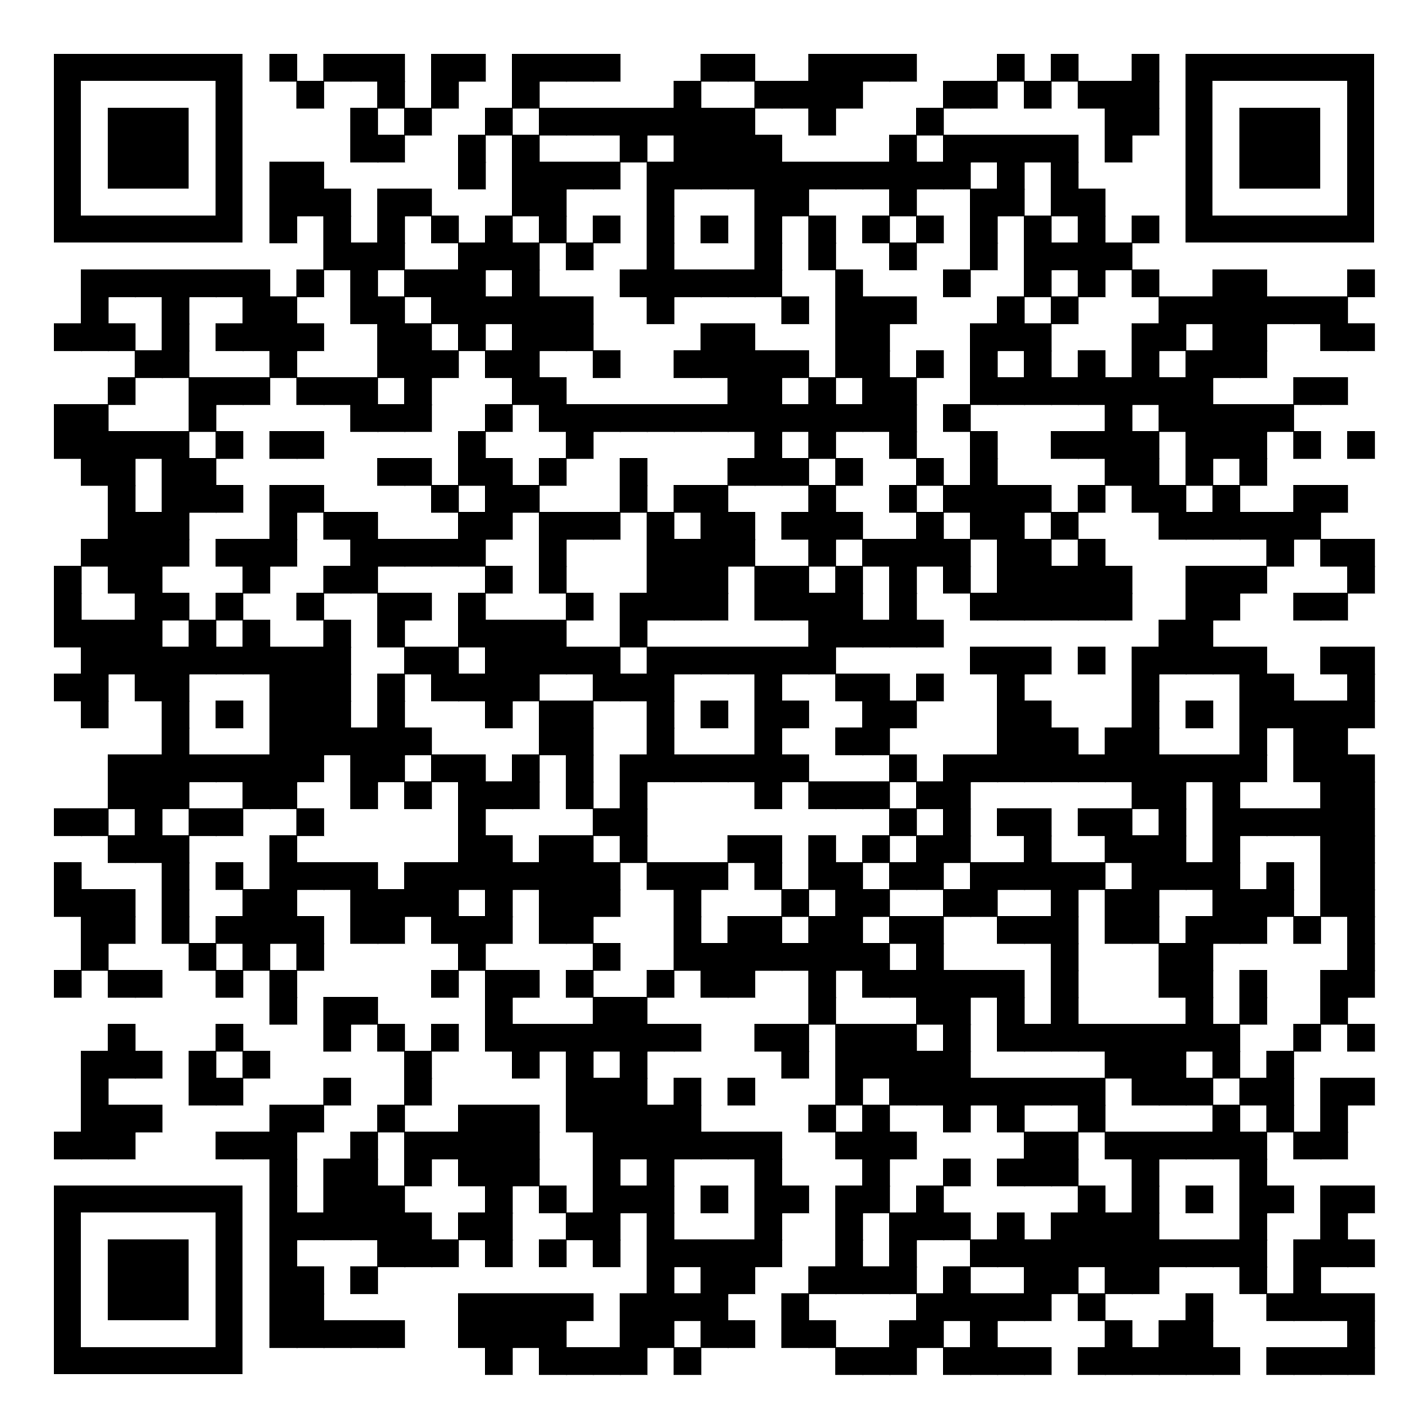

Thank you!
Any questions?
My Website ->
<- Slides
Add me on Linkedin ->

